Slide 1

Credit card fraud
Team #6
Raul Garcia
Mude Gayathri

Slide 2

Problem
Credit card company has fraudulent transactions affecting their customers accounts
We were given a data set filled with many transactions that have been settled as fraudulent or not to help prevent future frauds

Slide 3

Objective
The objective of this project is to create an effective model that can detect If future transactions have experienced fraud or not.
We were given 160,000 transactions with 200 parameters which we will analyze to create a working model

Slide 4

Preprocessing
Identified and filled in missing data
Binary code (0 – 141959, 1- 18040)
Standard scaler
70/30 training and testing data split
Smote to balance out the data

Slide 5
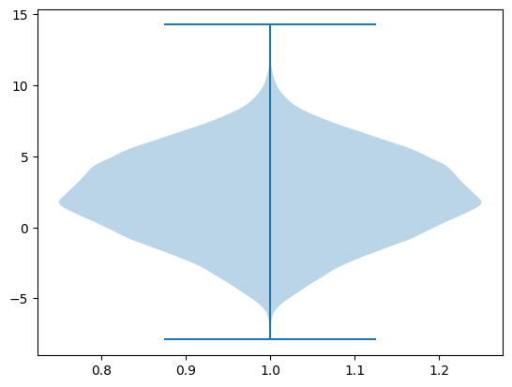
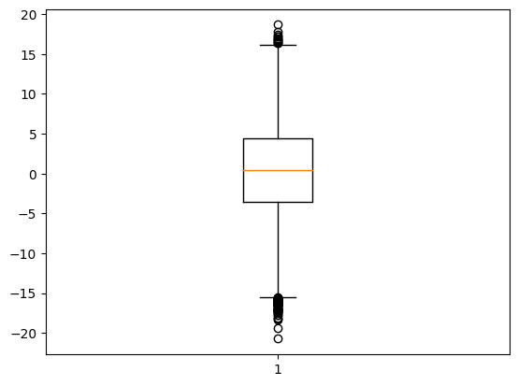
Preprocessing visuals
Top image (violin plot)
Represents variable x28
Most frequent between 0 and 5
Bottom image (Box plot)
Represents variable x2
There is no apparent skew
Many positive and negative outliers

Slide 6
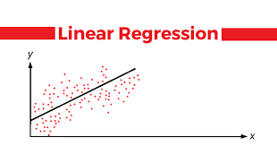
Linear regression model
used smote to balance data
70/30 training and test split

Slide 7
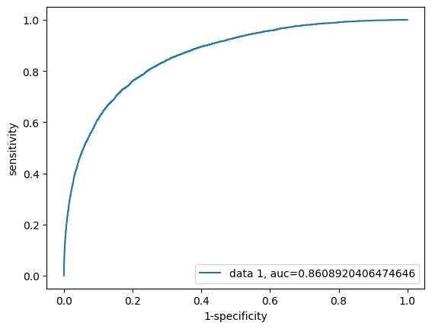
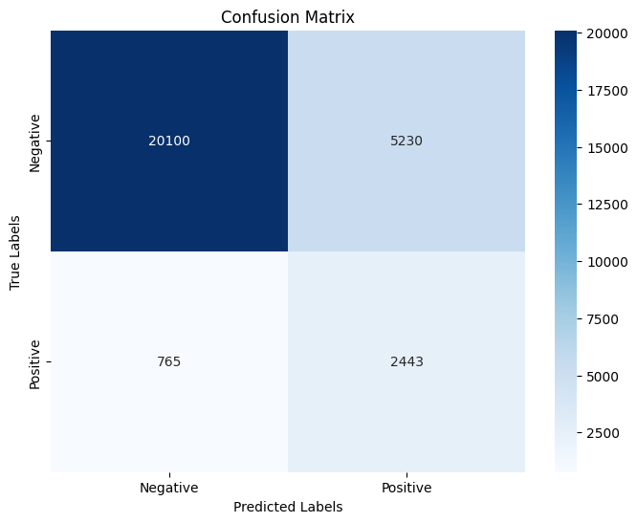
Linear regression results
Accuracy = 0.787125
Precision = 0.31199
Recall = 0.7693
F1 = 0.4439

Slide 8
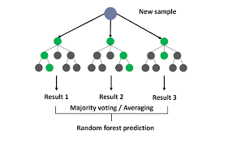
Random forest model
Same pre processing
Deliverable 2 to compare trees models performance

Slide 9
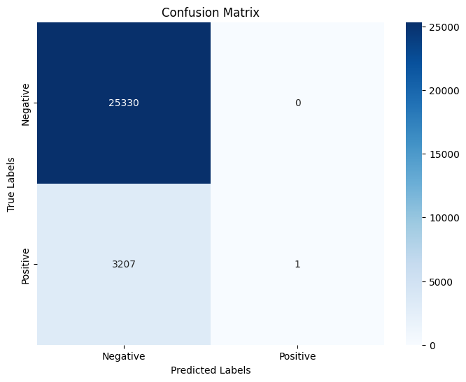
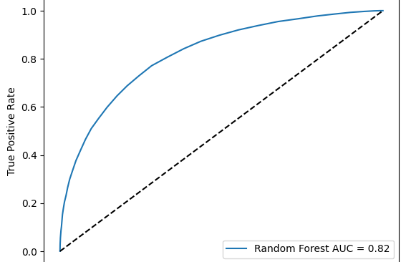
Random forest model results
Accuracy = 0.8876
Precision = 1
Recall = 0.0003117
F1 = 0.000623
AUC = 0.818

Slide 10
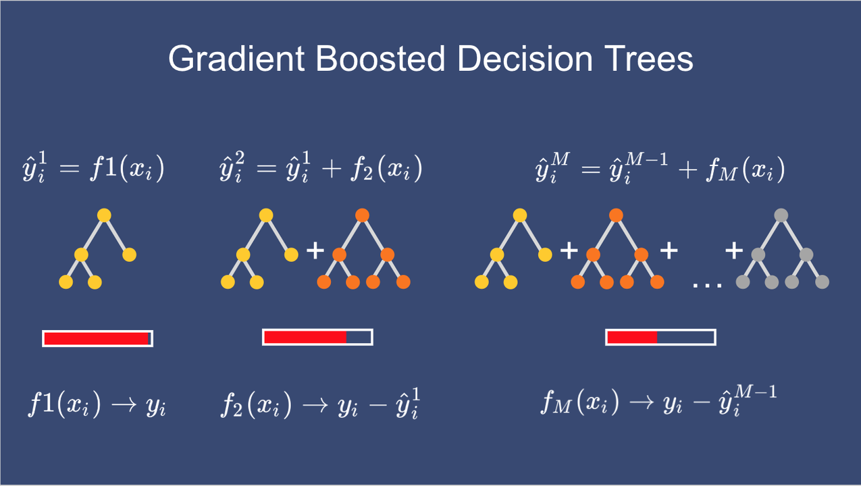
Gradient boosting model
Same preprocessing
Chose this model to compare another tree-based model to random forest

Slide 11
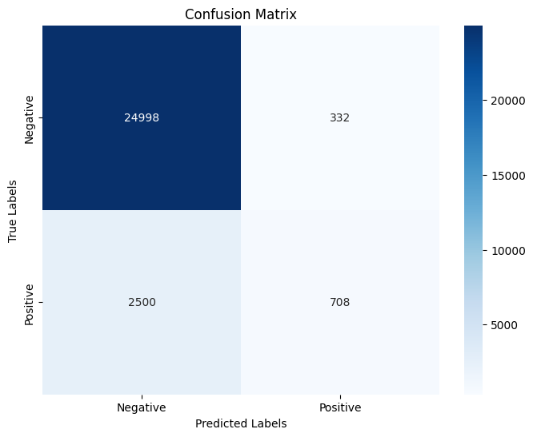
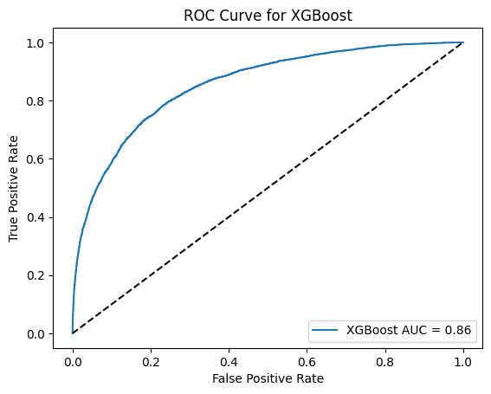
Gradient boosting results
Accuracy = 0.9007
Precision = 0.68
Recall = 0.22
F1 = 0.33
AUC= 0.844

Slide 12
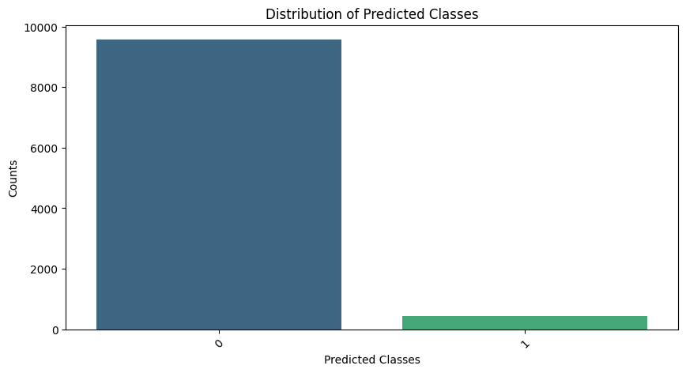
Testing Data
Used the GBM model
{0: 9575, 1: 426} (results of the model on test data)

Slide 13

Lessons learned
We learned a lot about preprocessing data and how to apply it to both the training data and testing data set
We learned how to overcome errors when it comes to preprocessing data
We learned it is a good idea to turn in your CSV

Slide 14

Thank you!

